Slide 1
UNIT -2 Performance

Slide 2
Performance
The program is genuinely too slow, and
there is some expectation that it can be made faster while maintaining correctness, robustness, and clarity
A fast program that gets the wrong answer doesn't save any time.

Slide 3
Bottleneck
Our incoming mail funnels through a machine. called a gateway, that connects our internal network with the external Internet.
Electronic mail messages from outside tens of thousands a day for a community of a few thousand people-arrive at the gateway and are transferred to the internal network
One of the services of the gateway is to filter out "spam.”

Slide 4

The gateway machine already very busy, was overwhelmed because the filtering program was taking so much time-much more time than was required for all the other processing of each message-that the mail queues filled and message delivery was delayed by hours while the system struggled to catch up.

Slide 5
Simplifying quite a bit. the spam filter runs like this
Each incoming message is treated as a single string, and a textual pattern matcher examines that string to see if it contains any phrases from known spam
None of the existing string-matching tools, such as grep, had the right combination of performance and packaging.
A special-purpose spam filter was written.

Slide 6
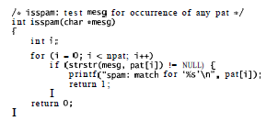

Slide 7
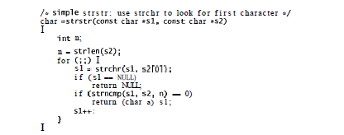
Using proflier, it became clear that the implementation of s t r s t r had unfortunate properties when used in a spam filter.

Slide 8
First, strncmp takes as an argument the length of the pattern. which must be computed with strlen.
But the patterns are fixed, so it shouldn't be necessary to recompute their lengths for each message.
Second, strncmp has a complex inner loop.
It must not only compare the bytes of the two strings, it must look for the terminating \O byte on both strings while also counting down the length parameter. Since the lengths of all the strings are known in advance.

Slide 9
Third, strchr is also complex, since it must look for the character and also watch for the \O byte that terminates the message.
For a given call to isspam, the message is fixed, so time spent looking for the \O is wasted since we know where the message ends.
Finally, although strncmp, strchr, and strlen are all efficient in isolation, the overhead of calling these functions is comparable to the cost of the calculation they will perform. It's more efficient to do all the work in a special, carefully written version of strstr and avoid calling other functions altogether.

Slide 10
With this in mind, strstr was rewritten to walk the pattern and message strings together looking for matches, without calling subroutines
The resulting implementation has predictable behavior: it is slightly slower in some cases, but much faster in the spam filter and, most important, is never terrible
To verify the new implementation's correctness and performance, a performance test suite was built.

Slide 11

The most effective way to make a program faster is to use a better algorithm.
With a clearer idea of the problem, it's time to think about what algorithm would work best.
The basic loop scans down the message npat independent times; assuming it doesn't find any matches, it examines each byte of the message npat times, for a total of strlen (mesg) *npat comparaisons.

Slide 12

A better approach is to invert the loops, scanning the message once in the outer loop while searching for all the patterns in parallel in the inner loop:

Slide 13
Given some precomputation to construct a table of which patterns begin with each character, i sspam is still short:

Slide 14
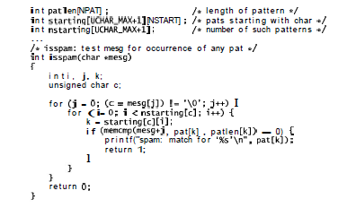

Slide 15
The two-dimensional array starting [c] [i] stores, for each character c, the indices of those patterns that begin with that character.
Its companion n s t a r t i ng[c] records how many patterns begin with c.
Without these tables, the inner loop would run from to npat, about a thousand;
instead it runs from 0 to something like 20. Finally, the array element patl en[k] stores the precomputed result of s t r l en(pat [k]).

Slide 16
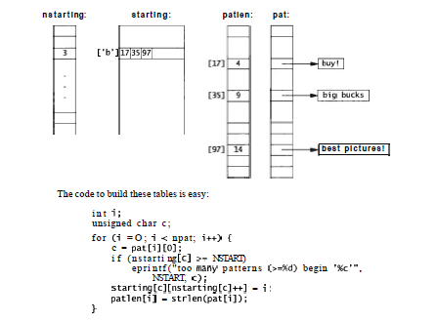

Slide 17
Depending on the input, the spam filter is now five to ten times faster than it was using the improved strstr , and seven to fifteen times faster than the original implementation
Performance problem solved.

Slide 18

2. Timing and Profiling
Automate timing measurements. Most systems have a command to measure how long a program takes.
On Unix. the command is called time:

Slide 19
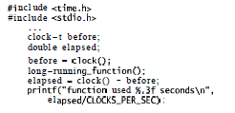
C and C++ provide a standard routine, clock, that reports how much CPU time the program has consumed so far. It can be called before and after a function to measure CPU usage:

Slide 20

The scaling term, CLOCKS-PER-SEC, records the resolution of the timer as reported by clock.
If the function takes only a small fraction of a second, run it in a loop. but be sure to compensate for loop overhead if that is significant:

Slide 21
Use a profiler
A profiler is a measurement of where a program spends its time.
Some profiles list each function, the number of times it is called, and the fraction of execution time it consumes.
Others show counts of how many times each statement was executed.
Statements that are executed frequently contribute more to run-time, while statements that are never executed may indicate useless code or code that is not being tested adequately.

Slide 22
Profiling is an effective tool for finding hot spots in a program, the functions or sections of code that consume most of the computing time
Profiles should be interpreted with care, however.

Slide 23

Profiling is usually enabled with a special compiler flag or option.
The program is run, and then an analysis tool shows the results.
On Unix, the flag is usually -p and the tool is called prof:

Slide 24
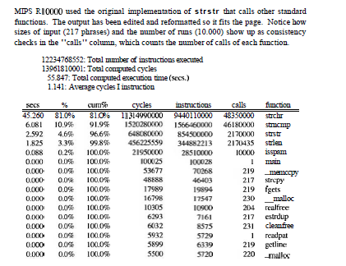

Slide 25
Concentrate on the hot spots
After rewriting strstr , we profiled spam test again and found that 99.8% of the time was now spent in strstr alone.
Even though the whole program was considerably faster.
When a single function is so overwhelmingly the bottleneck, there are only two ways to go: improve the function to use a better algorithm, or eliminate the function altogether by rewriting the surrounding program.

Slide 26
In this case, we rewrote the program. Here are the first few lines of the profile for pamtest using the final, fast implementation of i sspam.
Notice that the overall time much less.
That mcmp is now the hot spot, and that isspam now consumes a significant fraction of computation. It is more complex than the version that calleds t r s t r ,
but its cost is more than compensated for by eliminating strlen and strchr from isspam and by replacing strncmp with memcmp, which does less work per byte

Slide 27


Slide 28
It's instructive to spend some time comparing the cycle counts and number of calls in the two profiles.
Notice that s t r l e n went from a couple of million calls to 652, and that strncmp and memcmp are called the same number of times.
Also notice that isspam. which now incorporates the function of strchr, still manages to use far fewer cycles than strchr did before because it examines only the relevant patterns at each step.
Many more details of the execution can be discovered by examining the numbers.

Slide 29
Draw a picture.
Pictures are especially good for presenting performance measurements.
They can convey information about the effects of parameter changes, compare algorithms and data structures, and sometimes point to unexpected behavior.

Slide 30
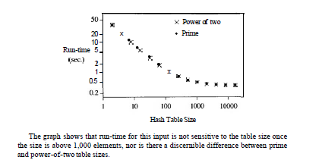

Slide 31
3. Strategies for Speed
a. Use a better algorithm or data structure.
The most important factor in making a program faster is the choice of algorithm and data structure;
even greater improvement is possible if the new algorithm reduces the order of computation, say from 0(n2) to O(nlogn).

Slide 32

Be sure that the complexity is really what you expect; if not, there might be a hidden performance bug. This apparently linear algorithm for scanning a string,

Slide 33
b. Enable compiler optimizations
One zero-cost change that usually produces a reasonable improvement is to turn on whatever optimization the compiler provides.
By default, most C and C++ compilers do not attempt much optimization.
A compiler option enables the optimizer

Slide 34
Compiler optimization usually improves run-time anywhere from a few percent to a factor of two
Sometimes, though, it slows the program down, so measure the improvement before shipping your product.

Slide 35
We compared un optimized and optimized compilation on a couple of versions of the spam filter.
However, some compilers have global optimizer, which analyze the entire program for potential improvements.

Slide 36

c. Tune the code
The right choice of algorithm matters if data sizes are big enough.
But once the right algorithm is in place, if speed is still an issue the next thing to try is tuning the code: adjusting the details of loops and expressions to make things go faster.

Slide 37

This initial version takes 6.6 seconds in our test suite when compiled using the optimizer.
The inner loop has an array index (nstarting [c]) in its loop condition whose value is fixed for each iteration of the outer loop.
We can avoid recalculating it by saving the value in a local variable:

Slide 38
d. Don't optimize what doesn't matter
Sometimes tuning achieves nothing because it is applied where it makes no difference.
Make sure the code you're optimizing is where time is really spent.
The engineers built a special instruction to encapsulate the function of the sequence,
rebuilt the system, and found it made no difference at all;
they had optimized the idle loop of the operating system.

Slide 39
Removing the array index from the inner loop was less dramatic, but still worth doing.
Optimizing public services like the spam filter is almost always worthwhile;
Speeding up test programs is almost never worthwhile.
And for a program that runs for a year, squeeze out everything you can.
It may be worth restarting if you find a way to make a ten percent improvement even after the program has been running for a month.

Slide 40
Competitive programs-games, compilers. word processors, spreadsheets, database systems-fall into this category as well, since commercial success is often to the swiftest, at least in published benchmark results.
It's important to time programs as changes are being made, to make sure that things are improving
Sometimes two changes that each improve a program will interact, negating their individual effects.

Slide 41
4. Tuning the Code
There are many techniques to reduce run-time when a hot spot is found.
Regression testing : be sure that the code still works.
good compilers will do some of these tuning.

Slide 42
Collect common sub expressions.
If an expensive computation appears multiple times. do it in only one place and remember the result.
Example:

Slide 43

If a computation is done within a loop but does not depend on anything that changes within the loop. move the computation outside, as when we replaced

Slide 44
2. Replace expensive operations by cheap ones.
The term reduction in strength refers to optimizations that replace an expensive operation by a cheaper one.
Division and remainder are much slower than multiplication. however, so there may be improvement if a division can be replaced with multiplication by the inverse, or a remainder by a masking operation if the divisor is a power of two.
Replacing array indexing by pointers in C or C++ might speed things up, although most compilers do.

Slide 45
Distance in the plane is determined by the formula sqrt(dx*dx+dy*dy).
so to decide which of two points is further away would normally involve calculating two square roots.
But the same decision can be made by comparing the squares of the distances;

Slide 46

3. Unroll or eliminate loops.
There is a certain overhead in setting up and running a loop.
If the body of the loop isn't too long and doesn't iterate too many times. it can be more efficient to write out each iteration in sequence. Thus, for example

Slide 47
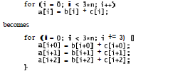
This eliminates loop overhead, particularly branching, which can slow modern processors by interrupting the flow of execution.

Slide 48
4. Cache frequently-used values.
Cached values don't have to be recomputed.
Caching takes advantage of locality, the tendency for programs (and people) to re-use recently accessed or nearby items in preference to older or distant data.
Web browsers, for instance, cache pages and images to avoid the slow transfer of data over the Internet.

Slide 49

The cache implementation used internal static variables to remember the previous character and its code:

Slide 50
5. Write a special-purpose allocator.
Often the single hot spot in a program is memory allocation, which manifests itself as lots of calls on malloc or new.
When most requests are for blocks of the same size, substantial speedups are possible by replacing calls to the general-purpose allocator by calls to a special-purpose one.
The special purpose allocator makes one call to ma1loc to fetch a big array of items, then hands them out one at a time as needed, a cheaper operation.

Slide 51
6. Buffer input and output.
Buffering batches transactions so that frequent operations are done with as little overhead as possible, and the high-overhead operations are done only when necessary.
When a C program calls printf, for example, the characters are stored in a buffer but not passed to the operating system until the buffer is full or flushed explicitly.

Slide 52
7. Handle special cases separately.
By handling same-sized objects in separate code, special-purpose allocators reduce time and space overhead in the general allocator and incidentally reduce fragmentation.
In the graphics library, the basic draw function was written to be as simple and straightforward as possible.

Slide 53
8. Precompute results.
Sometimes it is possible to make a program run faster by pre computing values so they are ready when they are needed
We saw this in the spam filter, which precomputed strlen(pat[il) and stored it in the array at patlen[i].

Slide 54
9. Use approximate values.
If accuracy isn't an issue, use lower-precision data types.
single-precision floating-point arithmetic is often faster than double-precision, so use float instead of double to save time.

Slide 55
10. Rewrite in a lower-level language.
Lower-level languages tend to be more efficient, although at a cost in programmer time.
Thus rewriting some critical part of a C++ or Java program in C or replacing an interpreted script by a program in a compiled language may make it run much faster.

Slide 56
7.5 Space Efficiency
Memory used to be the most precious computing resource, always in short supply, and much bad programming was done in an attempt to squeeze the most out of what little there was.
In any case, times have changed, and both main memory and secondary storage are amazingly cheap.
Thus the first approach to optimizing space should be the same as to improving speed.
There are still situations, however, where space efficiency matters.
If a program doesn't fit into the available main memory, parts of it will be paged out, and that will make its performance unacceptable.

Slide 57
1. Save space by using the smallest possible data type.
One step to space efficiency is to make minor changes to use existing memory better.
for example by using the smallest data type that will work. This might mean replacing i n t with short if the data will fit;
this is a common technique for coordinates in 2-D graphics systems, since 16 bits are likely to handle any expected range of screen coordinates. Or it might mean replacing double with float;
The logical extension of this approach is to encode information in a byte or even fewer bits, say a single bit where possible.

Slide 58

Don't use C or C++ bitfields; they are highly non-portable and tend to generate voluminous and inefficient code.
Instead, encapsulate the operations you want in functions that fetch and set individual bits within words or an array of words with shift and mask operations.
This function returns a group of contiguous bits from the middle of a word:

Slide 59
Don't store what you can easily recompute.
Changes like these are minor, however; they are analogous to code tuning.
Major improvements are more likely to come from better data structures, perhaps coupled with algorithm changes.
The program should be organized so that the specific data representation of complex types is hidden in a class or set of functions operating on a private data type.
Space efficiency concerns sometimes manifest themselves in the external representation of information as well, both conversion and storage.
Space efficiency often comes with a cost in run-time. One application had to transfer a big image from one program to another.

Slide 60
7.6 Estimation
It's hard to estimate ahead of time how fast a program will be, and it's doubly hard to estimate the cost of specific language statements or machine instructions.
It's easy, though, to create a cost model for a language or a system, which will give you at least a rough idea of how long important operations take.
One approach that is often used for conventional programming languages is a program that times representative code sequences.
There are operational difficulties, like getting reproducible results and canceling out irrelevant overheads, but it is possible to get useful insights without much effort.

Slide 61
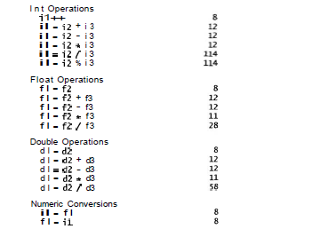

Slide 62
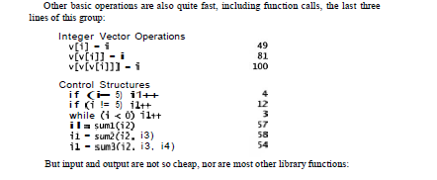

Slide 63
